Slide 1
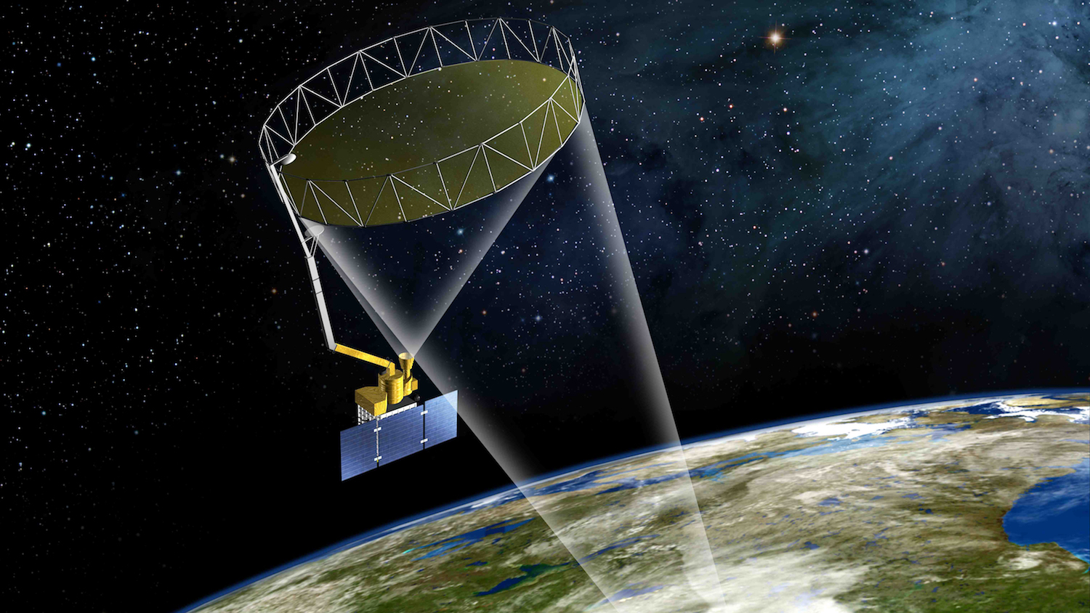
Sum and Difference Algorithm for Texture Analysis
Dhruvkumar Patil (200100056)
Sri Harsha Thota ()
Rajput Nikhileshsing Kailassing (200070067)
Guided by:
Prof. Buddhiraju K Mohan

Slide 2
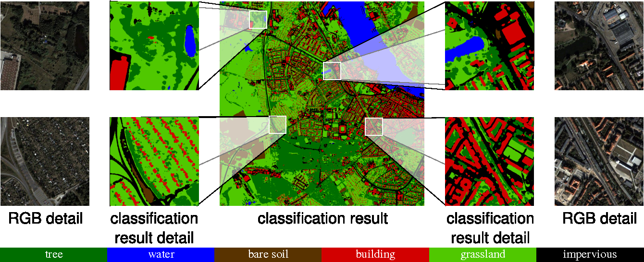
Texture Analysis
Texture analysis refers to the characterization of regions in an image by their texture content.
Fröhlich, Björn et al. “LAND COVER CLASSIFICATION OF SATELLITE IMAGES USING CONTEXTUAL INFORMATION.” ISPRS Annals of the Photogrammetry,
Remote Sensing and Spatial Information Sciences (2013): 1-6.

Slide 3
GLCM Algorithm and its Cons
Algorithm:
The GLCM is calculates how often a pixel. with gray-level (grayscale intensity or. Tone) value i occurs either horizontally, vertically, or diagonally to adjacent pixels with the value j .
Is used for extracting four Statistical Texture Parameters i.e., Entropy, Inverse Difference Moment, Angular Second Moment and Correlation
Cons:
Computationally intensive

Slide 4
Sum and Difference Algorithm
We would decorrelate the 2 axes of GLCM into sum and difference using PCA
Rather than computing whole GLCM, we will calculate 2 histograms
Gives comparable (to GLCM) results for 2nd order features

Slide 5
Moving Window Optimisation
Including values in connection
with this column
Dropping values in connection
with this column

Slide 6
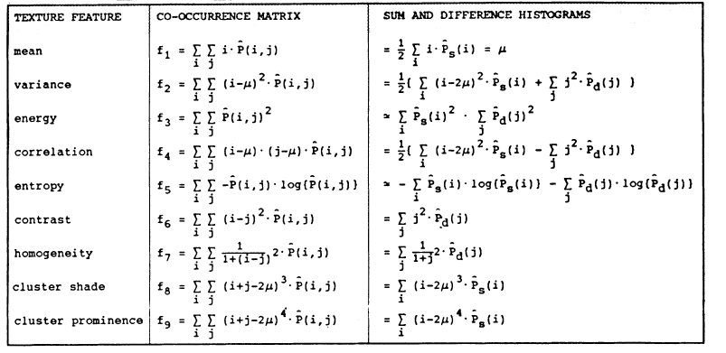
Feature Equivalence between GLCM and Sum-and-Difference
M. Unser, "Sum and Difference Histograms for Texture Classification," in IEEE Transactions on Pattern Analysis and Machine Intelligence, vol.
PAMI-8, no. 1, pp. 118-125, Jan. 1986, doi: 10.1109/TPAMI.1986.4767760.

Slide 7

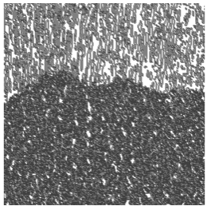
Result Comparision (ASM)
Sum-and-Difference
GLCM

Slide 8

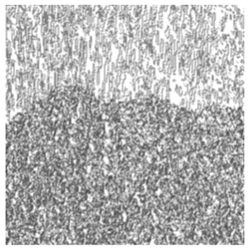
Result Comparision (IDM)
Sum-and-Difference
GLCM

Slide 9

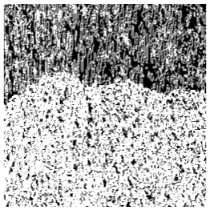
Result Comparision (ENT)
Sum-and-Difference
GLCM

Slide 10

Result Comparision (CON)
Sum-and-Difference
GLCM

Slide 11

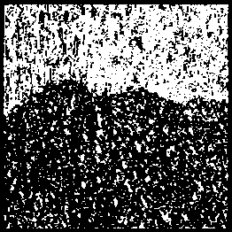
Output Image Comparision
Sum-and-Difference
GLCM

Slide 12
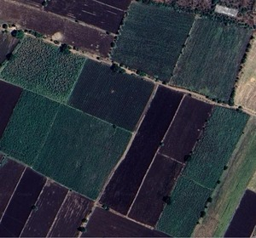
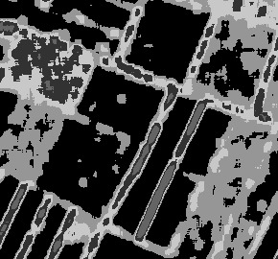
Result for Satellite Image
Input Image
Output Image

Slide 13
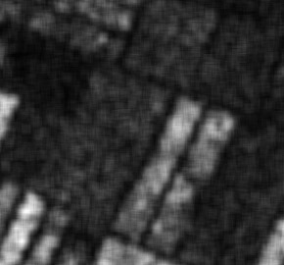
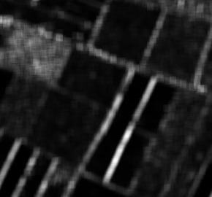
Result for Satellite Image
CON
IDM

Slide 14
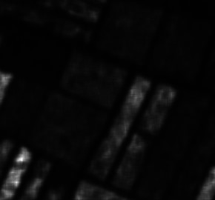
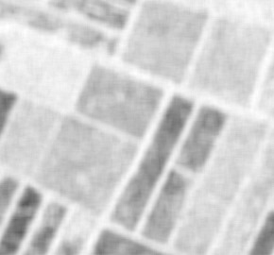
Result for Satellite Image
ASM
ENT

Slide 15
THANK YOU!!!

